Slide 1
Water Pollution : Sources, Effects and Engineering control Strategies

Slide 2
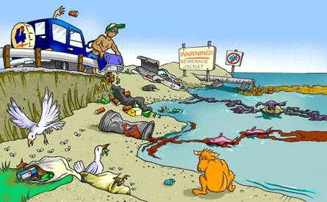
What is water pollution?
Water pollution is the contamination of water bodies (e.g. lakes, rivers, oceans, aquifers and groundwater), very often by human activities.
It occurs when pollutants (particles, chemicals or substances that make water contaminated) are discharged directly or indirectly into water bodies without enough treatment to get rid of harmful compounds.

Slide 3
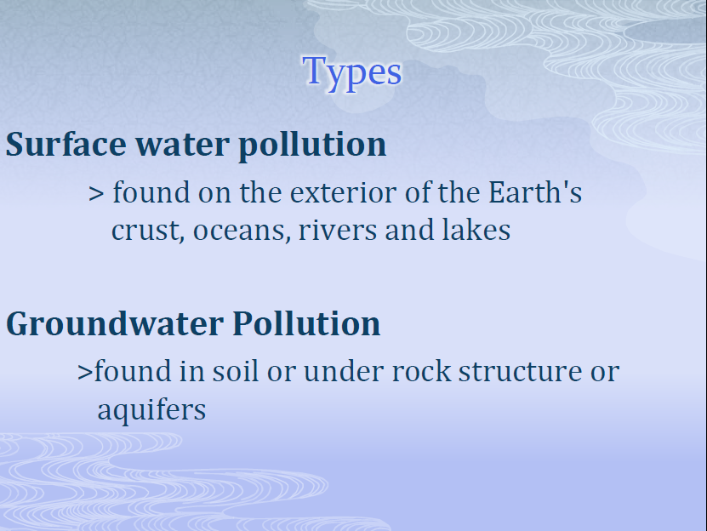
Pollutants get into water mainly by human causes or factors. Water pollution is the second most imperative environmental concern along with air pollution. Any change or modification in the physical, chemical and biological properties of water that will have a detrimental consequence on living things is water pollution.

Slide 4
Sources of Water Pollution
There are various classifications of water pollution. The two chief sources of water pollution can be seen as Point and Non-Point.

Slide 5












POINT SOURCE
pollution flowing from a single and identifiable source such as discharge pipe from a factory, roadway, or leaking underground storage tank
NON-POINT SOURCE
pollution collected by rain falling over a larger watershed which is then carried by runoff to a nearby lake or stream, or by infiltration into the groundwater

Slide 6
1.Point source pollution
Point source pollution refers to contaminants that enter a waterway through a discrete conveyance, such as a pipe or ditch.
Examples-
▫ discharges from a sewage treatment plant, a factory,
▫ a city storm drain.

Slide 7


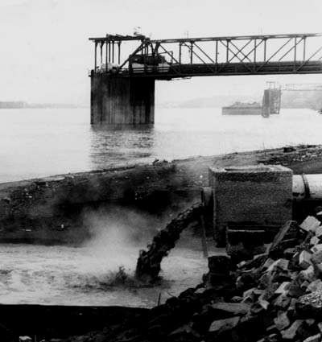

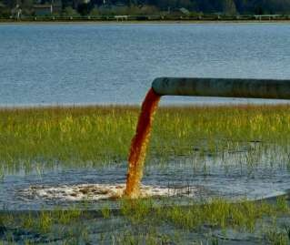

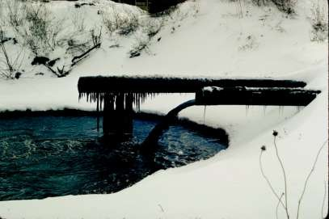
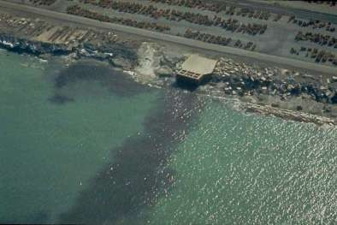



Slide 8









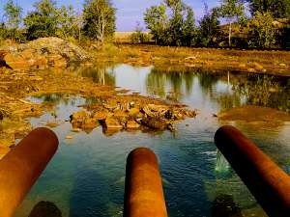

















Hazardous and toxic materials from manufacturing and industry discharged directly into the water - usually through a pipe or a leaky underground tank
Oil and gasoline
Solvents (toxic liquids)
Toxins and poisons
Heavy metals
(arsenic, lead, mercury, etc.
)
THERMAL POLLUTION - heated water causes the dissolved oxygen (DO) content in a body of water to decrease - can result in fish kills

Slide 9






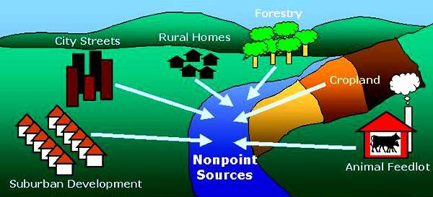

A HARDER PROBLEM TO SOLVE

Slide 10
2. Non-point source pollution
Non-point source (NPS) pollution refers to diffuse contamination that does not originate from a single discrete source.
NPS pollution is often accumulative effect of small amounts of contaminants gathered from a large area
The leaching out of nitrogen compounds from agricultural land which has been fertilized is a typical example.

Slide 11
What are the types of water
pollution?
There are many types of water pollution because water comes from many sources. Here are a few types of water pollution

Slide 12
1. Nutrients Pollution
Some wastewater, fertilizers and sewage contain high levels of nutrients. If they end up in water bodies, they encourage algae and weed growth in the water. This will make the water undrinkable, and even clog filters. Too much algae will also use up all the oxygen in the water, and other water organisms in the water will die out of oxygen starvation.

Slide 13
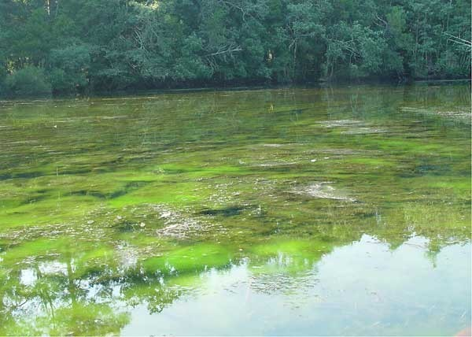

Slide 14
2. Surface water pollution
Surface water includes natural water found on the earth's surface, like rivers, lakes, lagoons and oceans. Hazardous substances coming into contact with this surface water, dissolving or mixing physically with the water can be called surface water pollution.

Slide 15
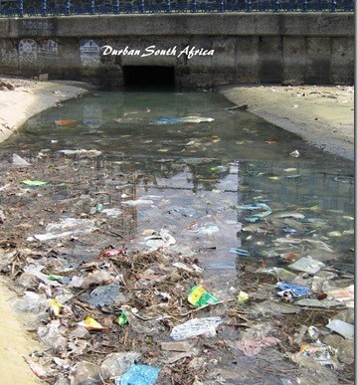

Slide 16
3. Oxygen Depleting
Water bodies have micro-organisms. These include aerobic and anaerobic organisms. When to much biodegradable matter (things that easily decay) end up in water, it encourages more microorganism growth, and they use up more oxygen in the water. If oxygen is depleted, aerobic organisms die, and anaerobic organism grow more to produce harmful toxins such as ammonia and sulfides.

Slide 17
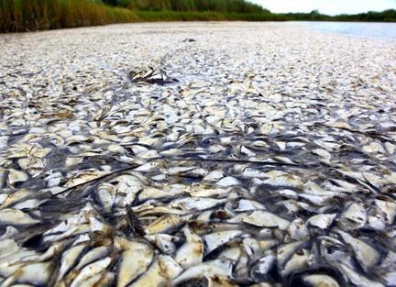

Slide 18
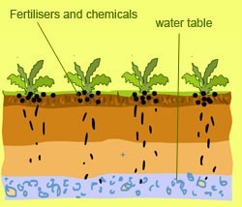
4. Ground water pollution
When humans apply pesticides and chemicals to soils, they are washed deep into the ground by rain water. This gets to underground water, causing pollution underground. This means when we dig wells and bore holes to get water from underground, it needs to be c er pollution.
hecked for ground wat

Slide 19
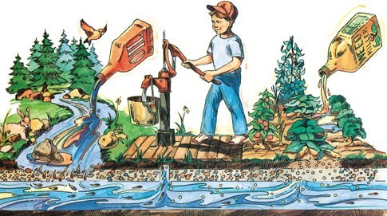

Slide 20
5. Microbiological
In many communities in the world, people drink untreated water (straight from a river or stream). Sometimes there is natural pollution caused by micro-organisms like viruses, bacteria and protozoa. This natural pollution can cause fishes and other water life to die. They can also cause serious illness to humans who drink from such waters.

Slide 21
6. Suspended Matter
Some pollutants (substances, particles and chemicals) do not easily dissolve in water. This kind of material is called particulate matter. Some suspended pollutants later settle under the water body. This can harm and even kill aquatic life that live at the floor of water bodies.

Slide 22
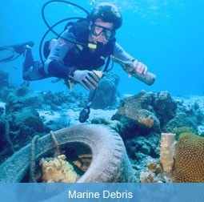

Slide 23
7. Chemical Water Pollution
Many industries and farmers work with chemicals that end up in water. This is common with Point-source Pollution. These include chemicals that are used to control weeds, insects and pests. Metals and solvents from industries can pollute water bodies. These are poisonous to many forms of aquatic life and may slow their development, make them infertile and kill them.

Slide 24
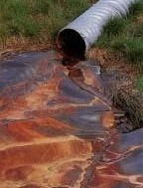

Slide 25
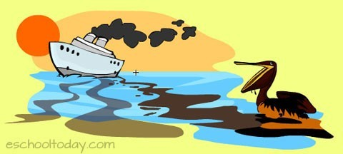
8. Oil Spillage
Oil spills usually have only a localized effect on wildlife but can spread for miles. The oil can cause the death to many fish and get stuck to the feathers of seabirds causing them to lose their ability
to fly.

Slide 26
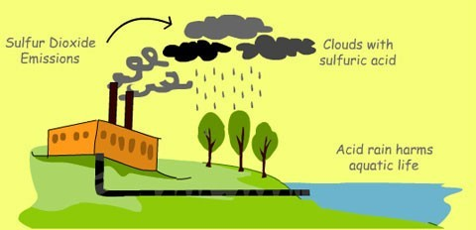
Industrial causes of water pollution
Industrial waste
Industries cause huge water pollution with their activities. These come mainly from: Sulphur – This is a non-metallic substance that is harmful for marine life.

Slide 27
Oil Pollution by Oil Industries
Routine shipping, run-offs and dumping of oils on the ocean surfaces happen everyday. Oil spills cause major problems, and can be extremely harmful to local marine wildlife such as fish, birds and sea otters and other aquatic life. Because oil does not dissolve, it stays on the water surface and suffocates fish. Oil also gets caught in the feathers of sea birds, making it difficult for them to fly. Some animals die as a result.

Slide 28
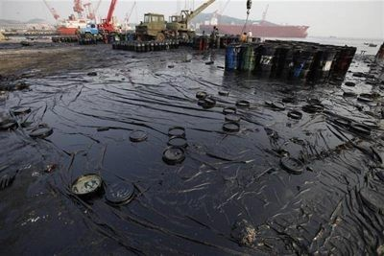

Slide 29
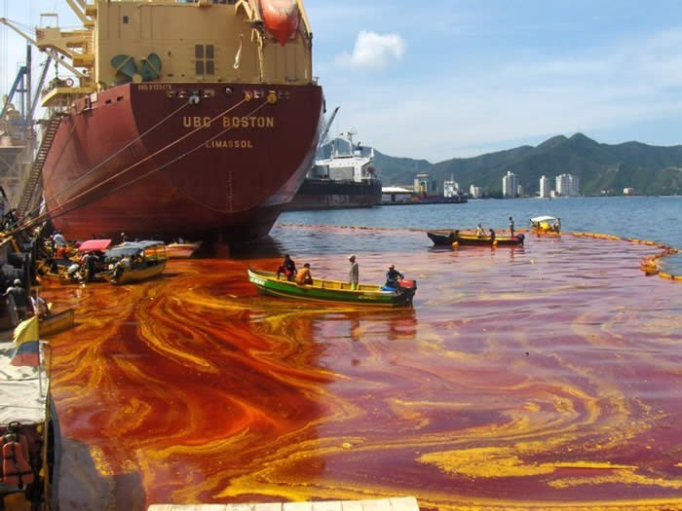

Slide 30
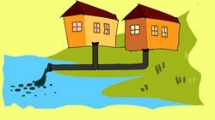
Other causes of water pollution
Sewage and waste water
Sewage is the term used for wastewater that often contains feces, urine and laundry waste. The sewage and waste water that is produced by each household is chemically treated and released in to sea with fresh water. The sewage water carries harmful bacteria and chemicals that can cause serious health problems. Pathogens are known as a common water pollutant.
A pathogen is any organism that causes disease. Viruses, bacteria, fungi, and parasites are all examples of pathogens

Slide 31
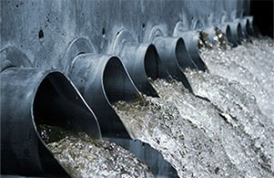

Slide 32
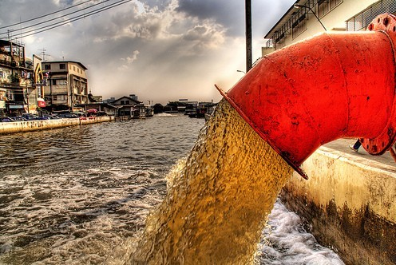

Slide 33
Mining activities
Mining is the process of crushing the rock and extracting coal and other minerals from underground. These elements when extracted in the raw form contains harmful chemicals and can increase the amount of toxic elements when mixed up with water which may result in health problems.

Slide 34
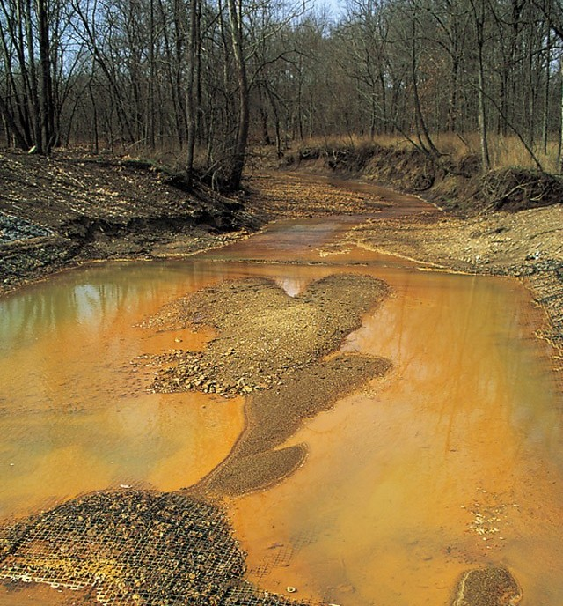

Slide 35
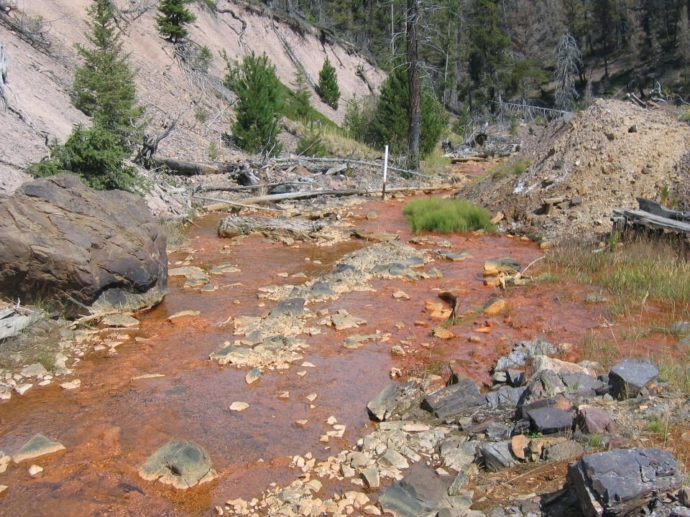

Slide 36

Ocean and marine dumping
Again, think of the rubbish we all make each day. Paper waste, food waste, plastic, rubber, metallic and aluminum waste. In some countries, they are deposited into the sea. All these waste types tak
e time to decompose.

Slide 37
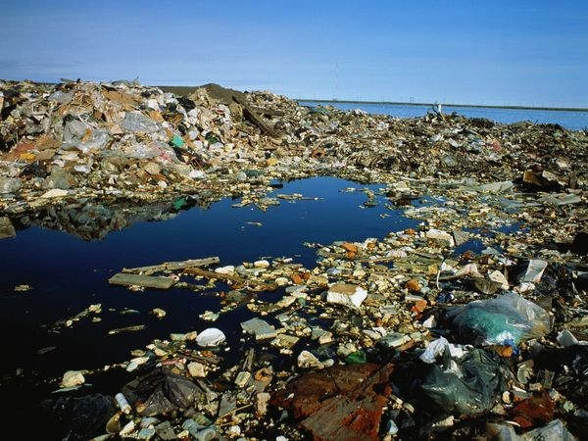

Slide 38
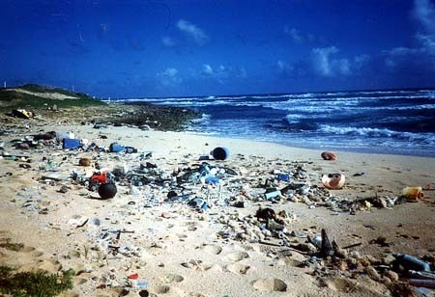

Slide 39
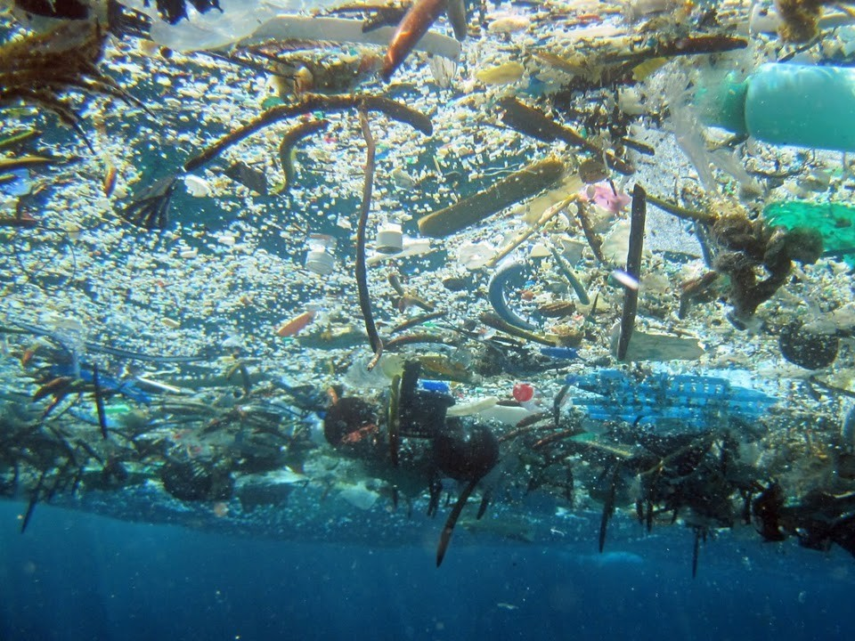

Slide 40
Underground storage and tube leakages
Many liquid products (petroleum products) are stored in metal and steel tubes underground. Other sewage systems run in underground tubes. Overtime, they rust and begin to leak. If that happens, they contaminate the soils, and the liquids in them end up in many nearby water bodies.

Slide 41
Effects of Water Pollution
The effects of water pollution are varied and depend on what chemicals are dumped and in which locations.
Many water bodies near urban areas (cities and towns) are highly polluted. This is the result of both garbage dumped by individuals and dangerous chemicals legally or illegally dumped by manufacturing industries, health centers, schools and market places.

Slide 42
Death of aquatic (water) animals
The main problem caused by water pollution is that it kills life that depends on these water bodies. Dead fish, crabs, birds and sea gulls, dolphins, and many other animals often wind up on beaches, killed by pollutants in their habitat (living environment).

Slide 43
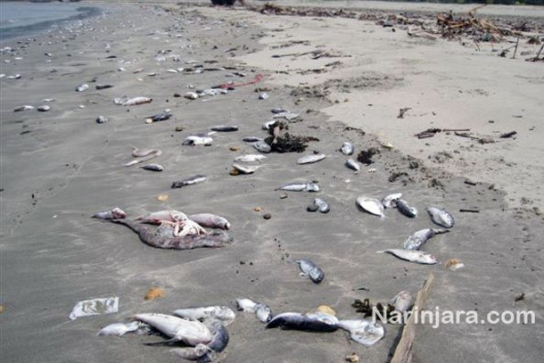

Slide 44
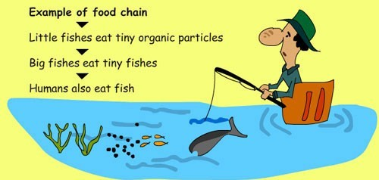
Disruption of food-chains
Pollution disrupts the natural food chain as well. Pollutants such as lead and cadmium are eaten by tiny animals. Later, these animals are consumed by fish and shellfish, and the food chain continues to be disrupted at all higher levels.

Slide 45
Diseases
Eventually, humans are affected by this process as well. People can get diseases such as hepatitis by eating seafood that has been poisoned. In many poor nations, there is always outbreak of cholera and diseases as a result of poor drinking water treatment from contaminated waters.

Slide 46
Destruction of ecosystems
Ecosystems (the interaction of living things in a place, depending on each other for life) can be severely changed or destroyed by water pollution. Many areas are now being affected by careless human pollution, and this pollution is coming back to hurt humans in many ways.

Slide 47
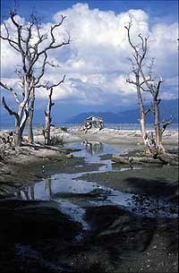

Slide 48
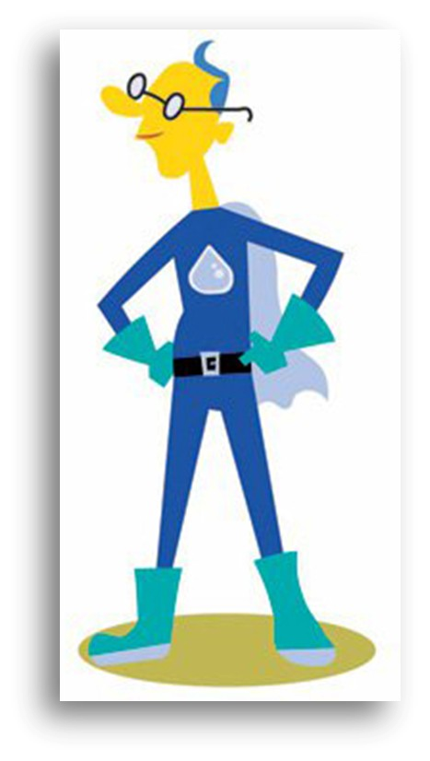
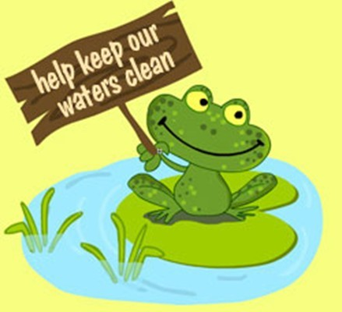
Prevention of Water Pollution
Dealing with water pollution is something that everyone (including governments and local councils) needs to get involved with.

Slide 49
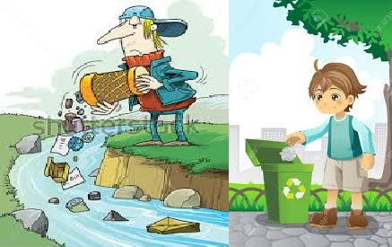
Never throw rubbish away anyhow. Always look for the correct waste bin. If there is none around, please take it home and put it in your trash can. This includes places like the beach, rive s.
rside and water bodie

Slide 50
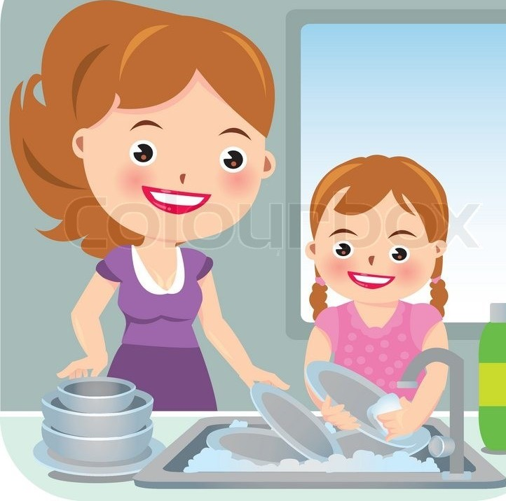
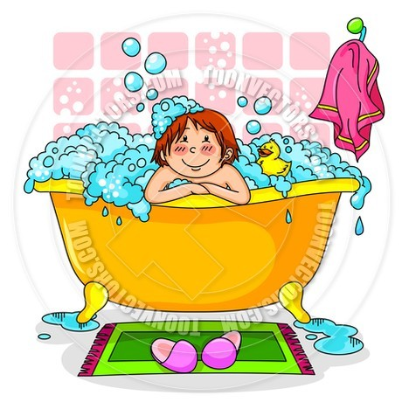
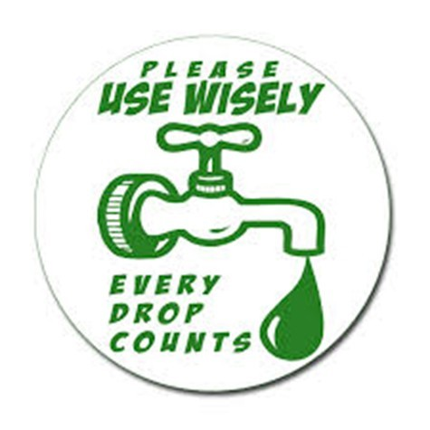
Use water wisely. Do not keep the tap running when not in use. Also, you can reduce the amount of water you use in washing and bathing. If we all do this, we can significantly prevent water shortages and reduce the amount of dirty water that needs treatment.

Slide 51
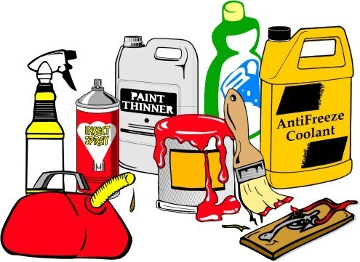
Do not throw chemicals, oils, paints and medicines down the sink drain, or the toilet. In many cities, your local environment office can help with the disposal of medicines and chemicals. Check with your local authorities if there is al
resident
a chemical disposal plan for loc
s.

Slide 52

Buy more environmentally safe cleaning liquids for use at home and other public places. They are less dangerous to the environment.

Slide 53
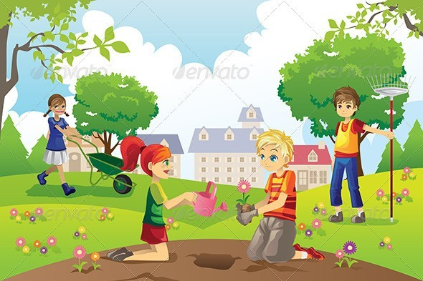
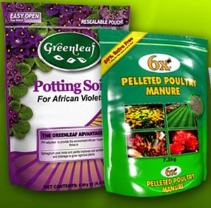
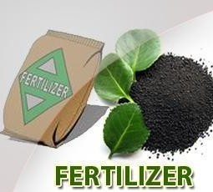
If you use chemicals and pesticides for your gardens and farms, be mindful not to overuse pesticides and fertilizers. This will reduce runoffs of the chemical into nearby water sources. Start looking at options of composting and using organic manure instead.

Slide 54
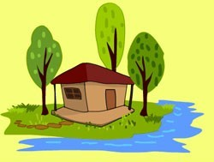
If you live close to a water body, try to plant lots of trees and flowers around your home, so that when it rains, chemicals from your home does not easily drain into the water.

Slide 55
Liquid Waste (Sewage/Wastewater) Treatment
Wastewater (liquid waste) from flushing the toilet, bathing, washing sinks and general cleaning goes down the drain and into a pipe, which joins a larger sewer pipe under the road. The larger pipe also joins a major pipe that leads to the treatment center.

Slide 56
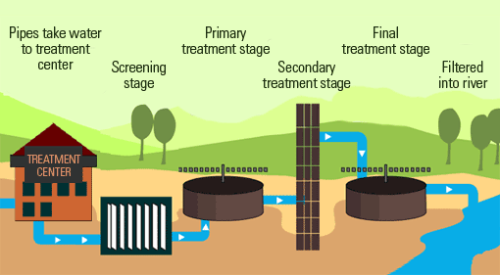

Slide 57


